Slide 1
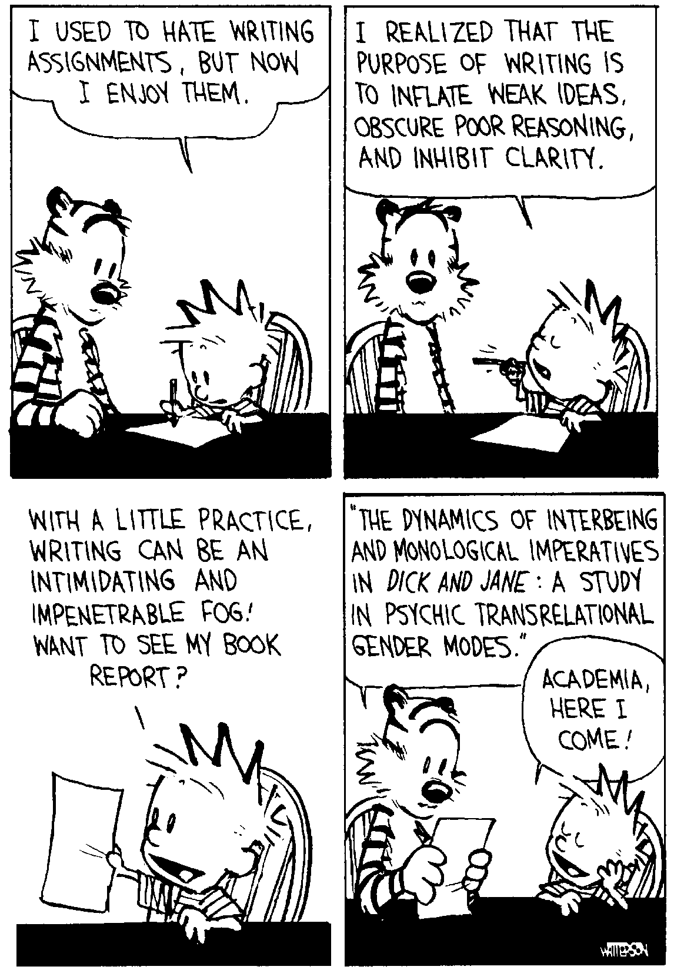

Slide 2

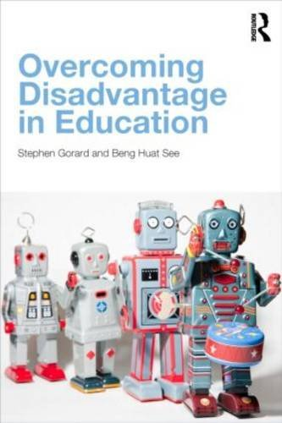
















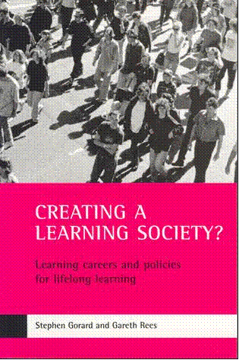







Evaluating education policy
How can teachers best use research evidence?
Stephen Gorard
Director, Durham University Evidence Centre for Education
s.a.c.gorard@durham.ac.uk
https://www.dur.ac.uk/dece/
@SGorard

Slide 3
Two dimensions of evidence-into-use, and who judges the quality of research?
 | Passive transfer | Engagement in transfer | (inter)Active transfer
Plain evidence | e.g. open access to journals | e.g. journal clubs | e.g. practitioner inquiry
Modified evidence | e.g. EEF Toolkit for practitioners | e.g. Think tanks | e.g. internships, research schools
Engineered evidence | e.g. lesson plans | e.g. hotlines, helpdesks | e.g. legislation for population measures
Source: Gorard, S., See, BH and Siddiqui, N. (2020) What is the evidence on the best way to get evidence into use in education?, Review of Education, DOI: 10.1002/REV3.3200

Slide 4
The first task of the reader is understand what the research is
A key task for the writer is to explain the research fully, to the widest possible audience
Abstract
This is a heterodidactic neuroscience, not materiality of language discussion. It is an article on intra-observation as research methodology, thus auditory, visual, cultural, syntactic, and paratactical body/mind/brain possibilities of words—Thinking ontology for post-qualitative methodology. Indirectly, it is about linguistic accountability of the event of/in education; the event of/in research—Thought in the act and/or bodily awareness in the moment: Nodal point waiting pentimento performances . . . and Jasmine. It might therefore be about a whole new transdisciplinary and humble body/mind/brain, education and research field all together, or about being a bit wild in the brain, and/to transfer something across areas and learning. It is a schizoanalysis crafting of knowledge attempt becoming data wise in action. My goal and hope are to foster self-reflexive think-languages and practices in Early Childhood Education and Care (ECEC) Institutions and schools. It is a professionalizing method.
Reinertsen, A. (2015) A wild multiple apparatus of knowing discussion: Waiting pentimento intra-observation, Qualitative Inquiry, 22, 4, 263–273

Slide 5

The attainment of children at LEO schools significantly outperforms national norms in national tests

Slide 6
Methodology for Changing Learning Changing Lives
This study is framed within an inductive-deductive interpretivist paradigm (Cohen, Manion & Morrison, 2007 ).
The design of this study adopts a phenomenological mindset - seeking to surface the implicit influences which have underpinned the evolution of LEO’s 1:1 approach.
the research was conducted in partnership with 16 middle, senior and executive leaders from across LEO Academy Trust rather than solely by an independent outsider-researcher.
No design
No counterfactual

Slide 7
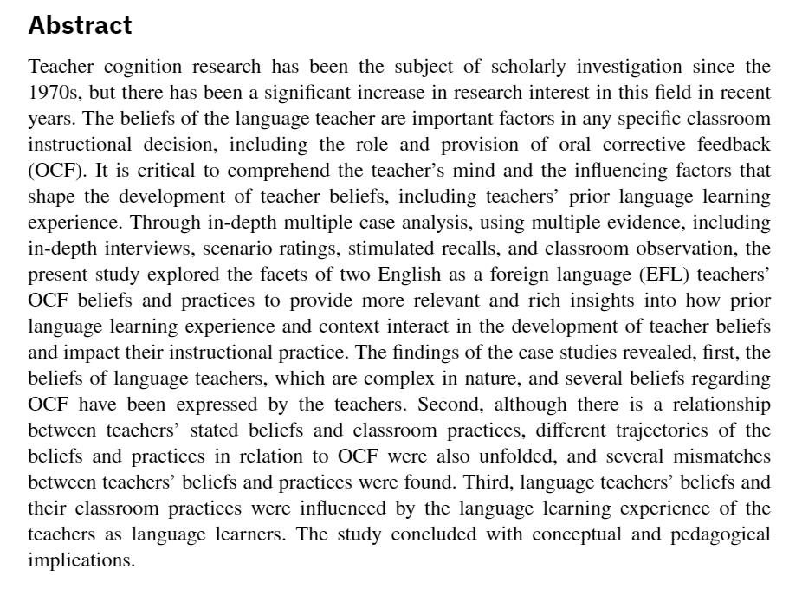

Slide 8
Abstract
A growing body of evidence indicates that the test scores of low-income children drop significantly relative to their higher-income counterparts during the summer months. This study used random assignment to evaluate the effectiveness of the Building Educated Leaders for Life (BELL) program--a summer program designed to improve academic skills, parental involvement, academic self-perceptions, and social behaviors among low-income children and families--and finds that a well-implemented summer learning program can improve reading test scores and increase the extent to which parents encourage their children to read during the subsequent school year. These findings provide some support for investments in out-of-school time programming for low-income children during the summer, such as those currently coming from the 21st Century Community Learning Centers program and the Supplemental Services provisions of Title I of the No Child Left Behind Act.
Overall, this study provides scientifically rigorous evidence regarding the ability of the BELL summer program to improve the reading skills of low-performing elementary school children. Few out-of-school time programs have produced evidence of effectiveness when evaluated in such a rigorous manner. The results are of particular importance given the longstanding public policy focus on raising achievement levels of low- income students.
Chaplin, D. and Capizzano, J. (2006) Impacts of a summer learning program: a random assignment study of Building Education Leaders for Life (BELL), Washington, DC: The Urban Institute, http://www.urban.org/UploadedPDF/411350_bell_impacts.pdf

Slide 9
In total there were 1,917 applicants to the BELL 2005 summer program at the three included sites, more than double the 750 slots available (250 at each site). Of these applicants, 1,225 had parents who signed a form allowing their child to be in the study before being informed of whether or not they would be accepted into the program… In order to be fair, participation in the study was not a condition for participation in the program so even those who refused to participate in the study were included in the lottery to decide who would be accepted to the program.
Within the group of 1,225 applicants whose parents agreed to let them be in the study, an
additional 43 cases were left out because they were in a randomization pool where either no one was accepted or everyone was accepted. Another 95 cases with only one child per family and with a probability of being accepted close to 0 or 1 were excluded during the data collection process due to cost considerations.
This left a sample of 1,087 applicants. Of these, we have complete test score data (including information on the day the test was taken) for 835 applicants for an overall weighted response rate of 78 percent for the control group and 78 percent for the treatment group.
Foot note 6. Thirty percent of the original sample did not agree to participate in the study and another twenty percent of those who remained did not provide data. About 34 percent of those in the treatment group did not participate in the BELL program and about 6 percent of the control group did.

Slide 10
Table 5 Estimated Impacts of being in the Treatment Group on Reading Test Scale Scores
Outcome Treat Control SD ES p-value N
Total Score 423 422 65 +0.02 0.67 847
Vocabulary 420 422 67 -0.03 -0.73 847
Comprehension 418 417 73 +0.02 0.45 847
“a well-implemented summer learning program can improve reading test scores”

Slide 11
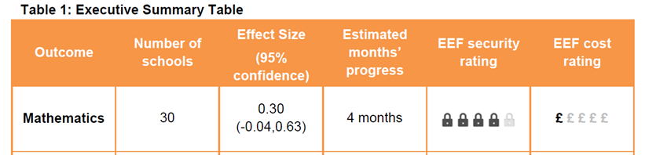
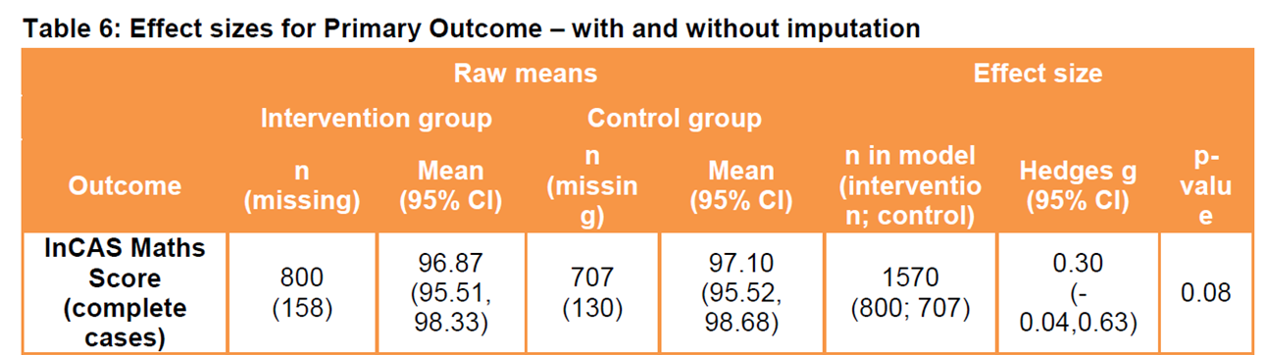
In this trial, pupils who participated in ReflectED (metacognition) made an average of four months’ additional progress in maths compared to pupils who did not. p.5
https://educationendowmentfoundation.org.uk/public/files/Projects/Evaluation_Reports/EEF_Project_Report_ReflectED.pdf

Slide 12
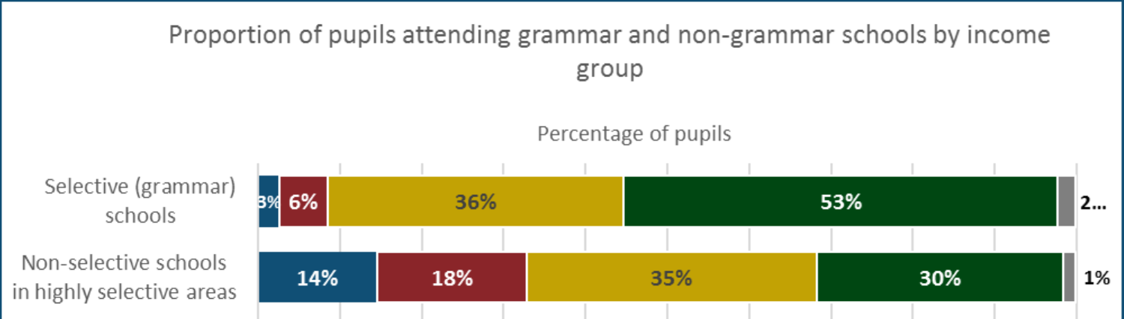

http://dera.ioe.ac.uk/28896/1/Technical%20consultation%20document.pdf

Slide 13
Contrary to what some people allege, official research shows that slightly more children from ordinary, working class families attend selective schools as a percentage of the school intake compared to nonselective schools.
(p.50 of the Conservative 2017 Manifesto)
https://s3.eu-west-2.amazonaws.com/manifesto2017/Manifesto2017.pdf).

Slide 14
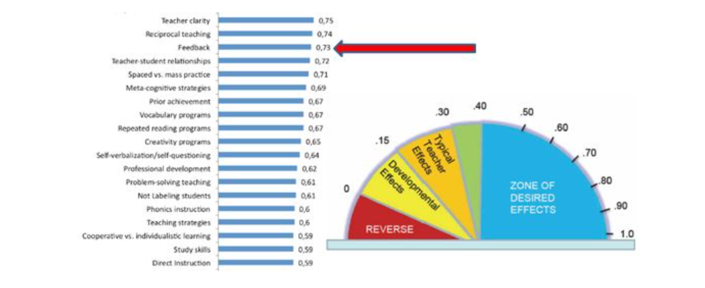
Many commentators, including John Hattie, have suggested that enhanced feedback in the classroom is a very effective approach to improving student learning
Source: Hattie, J. (2008) Visible learning, Routledge

Slide 15

EEF Teaching and Learning Toolkit agrees
Low cost, high impact and robust evidence in support

Slide 16
A ‘sieve’ to assist in the estimation of trustworthiness of any research study
Design | Scale | Completeness of data | Data quality | Rating
Strong design for research question | Large number of cases per comparison group | Minimal missing data, no evidence of impact on findings | Standardised, independent, pre-specified, accurate | 4🔒
Good design for research question | Medium number of cases per comparison group | Some missing data, possible impact on findings | Standardised, independent, not pre-specified, some errors | 3🔒
Weak design for research question | Small number of cases per comparison group | Moderate missing data, likely impact on findings | Not standardised, independent, or pre-specified, some errors | 2🔒
Very weak design for research question | Very small number of cases per comparison group | High level of missing data, clear impact on findings | Weak measures, high level of error, too many outcomes | 1🔒
No consideration of design | A trivial scale of study, or number is unclear | Huge amount of missing data, or not reported | Very weak measures, or accuracy not addressed | 0🔒
Source: Gorard (2021) How to make sense of statistics, SAGE

Slide 17
Impact of enhanced feedback in primary schools,
as assessed by 19 studies found in a systematic review
Number of studies reporting positive effect | Number of studies reporting no effect or damage
13 | 6
Source: Gorard, S., See, BH and Siddiqui, N. (2017) The trials of evidence–based education, London: Routledge

Slide 18
Quality and impact : studies of feedback
 | Number of studies reporting positive effect | Number of studies reporting no effect or damage
High quality 4🔒 | - | -
Higher quality 3🔒 | 1 | 1
Medium quality 2🔒 | 1 | 2
Low quality 1🔒 | 11 | 3
Reference | Intervention | Smallest cell | Attrition | Effect size | NNTD-attrition | Quality
Lang et al. 2014 | Formative Assessment | 15 schools, 2,000+ pupils | 1 school, unknown pupils | 0.20 | 500+ | 🔒🔒🔒
Phelan et al. 2011 | Feedback (Year 7) | 2,045 pupils | - | 0.03 | 0 | 🔒🔒🔒
Source: Gorard, S., See, BH and Siddiqui, N. (2017) The trials of evidence–based education, London: Routledge

Slide 19
Menu of Interventions
Please click the links in the table below to find out more about each intervention.
Intervention | Outcome | Year groups | Estimated impact | Evidence strength | Cost per pupil
Accelerated Reader | Literacy | 1-5 | 0.20 | 3🔒 | £10
LbQ | Literacy, numeracy | 2-6 | 0.10 | 2🔒 | (0)
Enhanced oral feedback | Literacy, numeracy | 1-4 | 0.20 | 3🔒 | 0
Student tutoring | Literacy, numeracy | 1-6 | 0.20 | 3🔒 | 0
Peer tutoring | Literacy, numeracy | 1-6 | 0.20 | 3🔒 | 0
Dialogic teaching | Literacy, numeracy | 1-5 | 0.20 | 3🔒 | £10
Texting parents | Literacy, numeracy | 1-6 | 0.10 | 3🔒 | 0
Self-affirmation | Literacy, numeracy | 2, 5, 6 | 0.10 | 2🔒 | 0

Slide 20
Selected relevant references
Gorard, S., See BH, and Siddiqui, N. (2022) Making schools better for disadvantaged students, Abingdon: Routledge
Gorard, S. (2020 Ed.) Getting evidence into education: Evaluating the routes to policy and practice, London: Routledge
Gorard, S. (2021) How to make sense of statistics: Everything you need to know about using numbers in social science, London: SAGE
Gorard, S. (2018) Education policy: Evidence of equity and effectiveness, Bristol: Policy Press
Gorard, S., See, BH and Siddiqui, N. (2017) The trials of evidence-based education, London: Routledge
See, BH, Gorard, S., Lu, B., Dong, L. and Siddiqui, N. (2021) Is technology always helpful?: A critical review of the use of education technology in supporting formative assessment in schools, Research Papers in Education, https://doi.org/10.1080/02671522.2021.1907778
See, BH and Gorard, S. (2020) Effective classroom instructions for primary literacy? A critical review of causal evidence, International Journal of Educational Research, 102, https://www.sciencedirect.com/science/article/pii/S0883035519317719?dgcid=coauthor
Gorard, S., See, BH and Siddiqui, N. (2020) What is the evidence on the best way to get evidence into use in education?, Review of Education, DOI: 10.1002/REV3.3200

